Slide 1
Group Project
Dr. Junbum Kwon
Aug 3 2018

Slide 2
The types of Group Project
Data + AI methods
<1> New Data Product
Start-up idea?
<2> Data Analytics
Actionable results (Interpretation)
Good enough analytics

Slide 3
<1> AI-driven New Data Product
(1)Problems that you want to solve
(2)Benefit for your target customer
(3)Your approach: Data + AI tools
(4)Plan to make money

Slide 4
(1)Problems that you want to solve
Read articles about AI start-ups & major IT firms
Share it in Microsoft Teams (at least once per week)
Global challenging problem list
UNSW Grand Challenges, D-Prize, Microsoft AI for Earth, UN Global Issue, BBC Grand Challenges, Data.gov, Intel, …
Something that you are very familiar in your daily life
Around you, your place, UNSW, …

Slide 5
Articles about AI firms
Welcome AI on recent AI products
https://www.welcome.ai/
AI news - https://www.artificialintelligence-news.com/
Techworld - https://www.techworld.com
CB Insights tech market intelligence platform
Analyzes venture capital, startups, patents, partnerships and news mentions
https://www.cbinsights.com/

Slide 6
Articles about AI firms
https://www.nanalyze.com/2018/06/10-biggest-artificial-intelligence-startups/
https://www.datamation.com/artificial-intelligence/top-ai-startups.html
https://www.cbinsights.com/research/artificial-intelligence-top-startups/
https://news.crunchbase.com/news/top-20-well-funded-ai-startups-watch/
https://www.smartbrief.com/original/2018/02/beyond-chatbots-3-ways-ai-will-revolutionize-grocery-industry
https://martechtoday.com/three-ai-marketing-trends-for-brick-and-mortar-retailers-214917
https://www.cbinsights.com/research/apple-health-care-strategy-apps-expert-research/
https://www.wareable.com/wareable50/best-wearable-tech-2017
https://www.psychiatryadvisor.com/top-10-mental-health-apps/slideshow/2608/
…

Slide 7
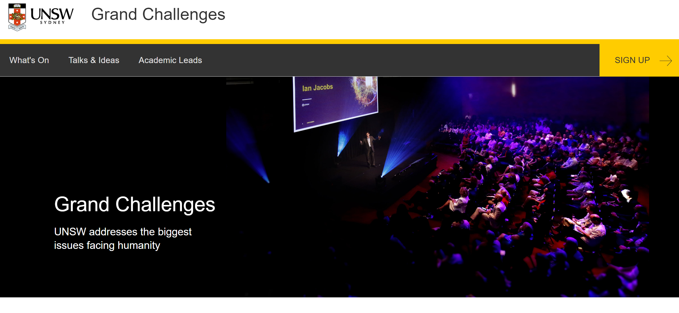
UNSW Grand Challenges
Climate Change,
Refugees & Migrants,
Inequality, and
Living with 21st Century Technology
http://www.grandchallenges.unsw.edu.au/

Slide 8
D-Prize Challenges
D-Prize funds new entrepreneurs who increase access to proven poverty interventions.
The world has already invented ways to end poverty, yet the best interventions are not being distributed at mass-scale. Can you design a business or NGO that solves one of the Distribution Challenges below?
If selected we will award you up to $20,000 to launch a pilot in any region where extreme poverty exists.

Slide 9
D-Prize Challenges
+ GIRL'S EDUCATION
+ AGRICULTURE
+ ENERGY
+ GLOBAL HEALTH
+ EDUCATION
+ GOVERNANCE AND INFRASTRUCTURE
+ CUSTOM
https://www.d-prize.org/#know

Slide 10
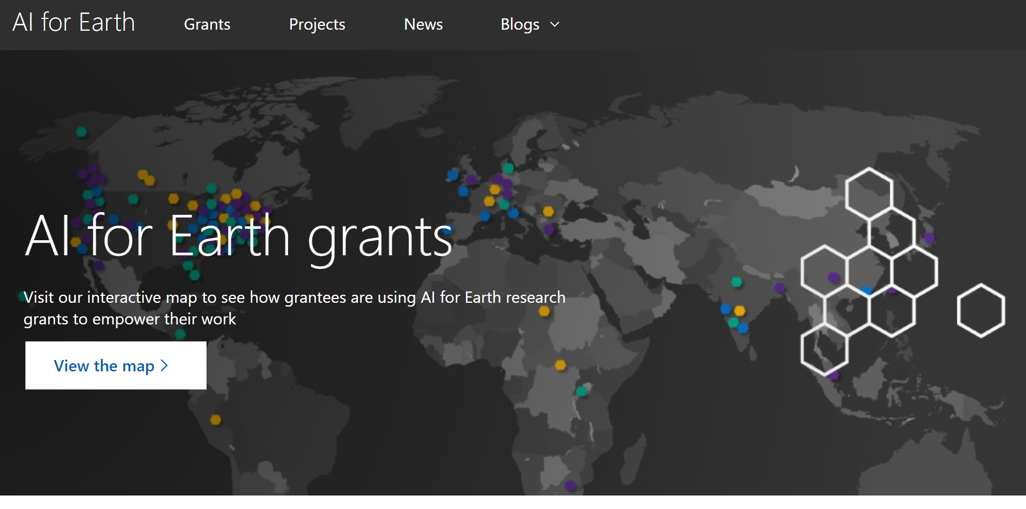
Microsoft AI for Earth Grants
https://www.microsoft.com/en-us/aiforearth/grants.aspx

Slide 11
Microsoft AI for Earth Grants
Agriculture
To feed the world’s rapidly growing population, farmers must produce more food, on less arable land, and with lower environmental impact.
Water
Biodiversity
Climate Change

Slide 12
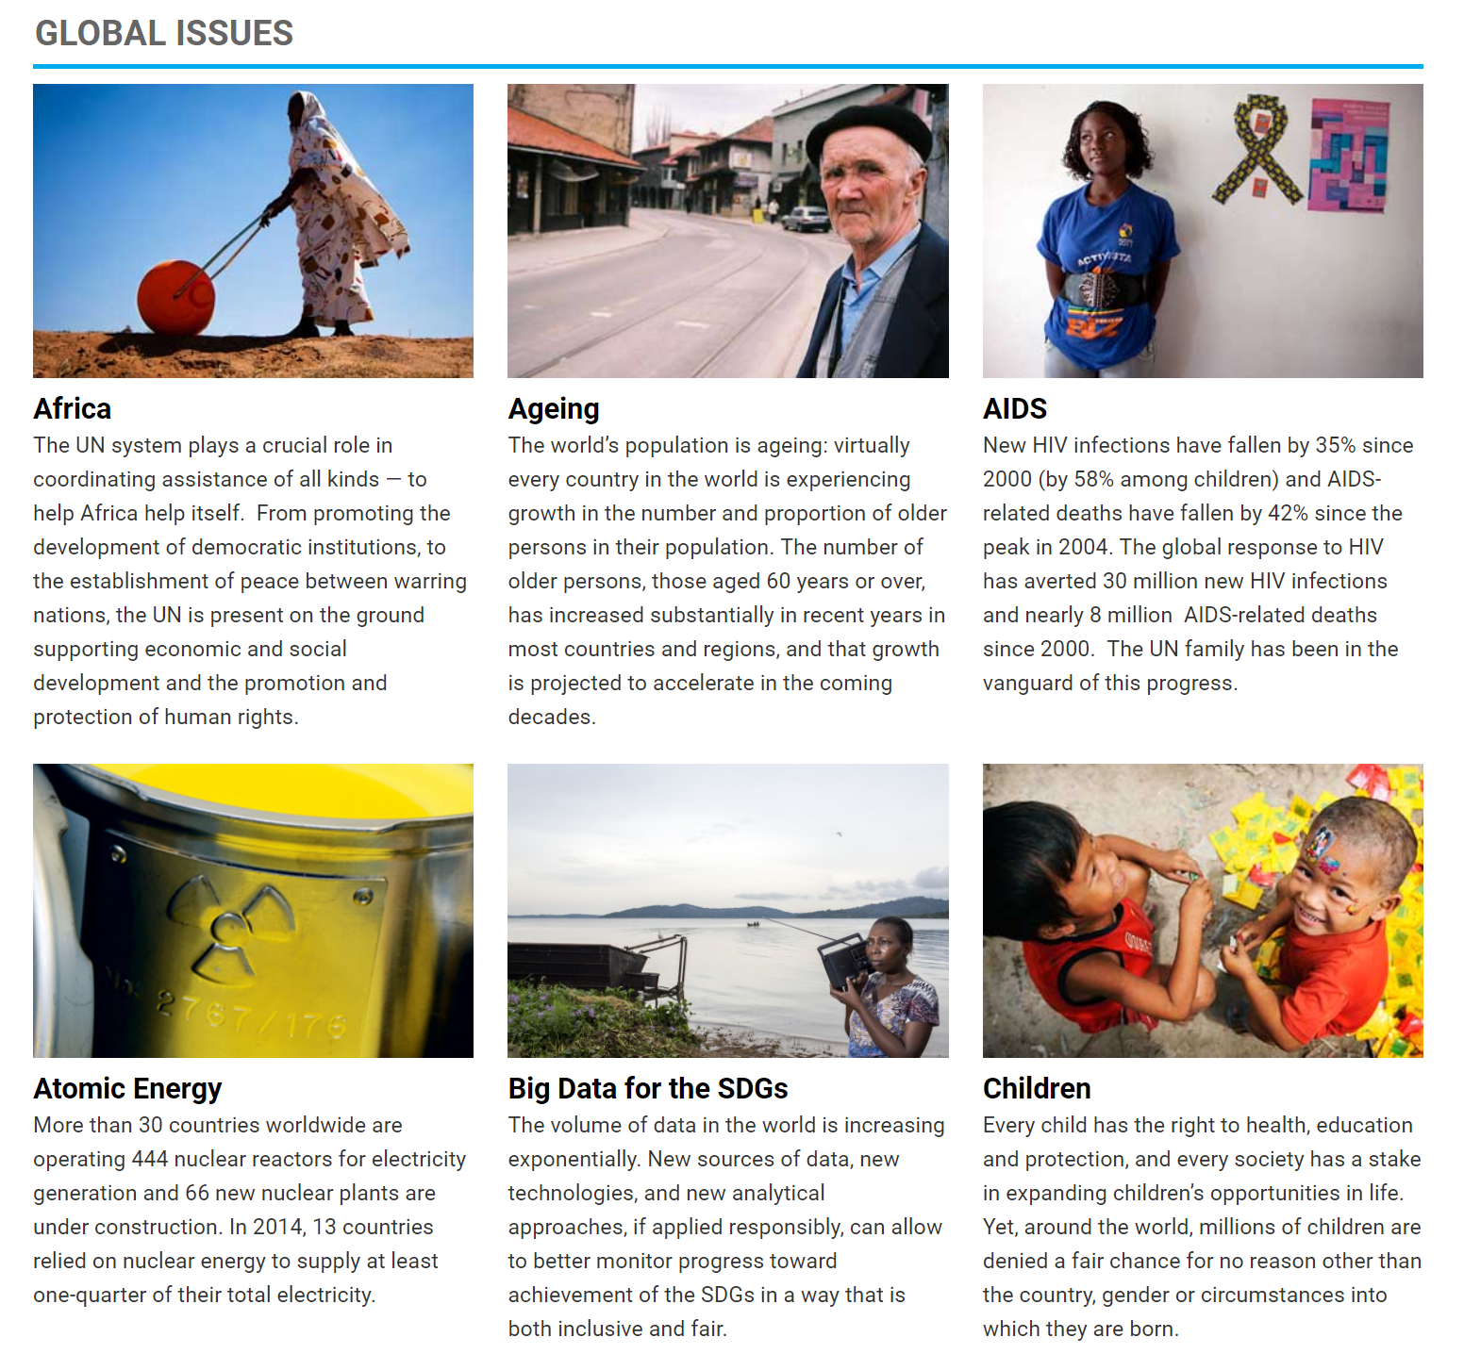
United Nations
http://www.un.org/en/sections/issues-depth/global-issues-overview/

Slide 13
Specify your data product idea
You can’t solve global challenges at one semester.
Try to narrow down the scope considering given time.

Slide 14
Familiar topics in your daily life - AI for Woolworths by Marketing AI lab
Personalized “For You” page. Product recommendations.
Woolworths Recipe App Upgrades
Improving Customer Experience – Automatics Shopping Lists
Improving Customer Experience – Guiding the way to products
Reducing Costs and Improving Efficiencies – Supply Chain Management
Reducing Theft – Self Serve Checkout Upgrades
Reducing Theft – Randomized Self Serve Monitoring
Leveraging Rewards – Providing more access to rewards

Slide 15
Automatic Shopping list
Observations
Many people still use paper shopping lists.
Customer benefit
Streamline the process and making things faster can improve the customer experience

Slide 16
Automatic Shopping list
Scan and convert a real life paper shopping list from image to text through Woolworths App.
Provide a basics / essentials shopping list (frequent buys) as a starting point, instead of just blank list.
Suggest new items / products based on previous search and purchase history.
Can suggest list of items to customer after inputting basic demographical info – family of 2, working, allergies etc.

Slide 17
(2)Benefit for your target customer
Who is your target customer?
Individual or company?
Your customer profile
What does your competitors offer?
What is your customer’s unmet needs?
What benefit do you plan to offer?

Slide 18
(3)Your approach: Data + AI tools
Can current AI technology meet the customer benefit?
Which AI tools?
What data are necessary?
If not,
Draw long-term roadmap
For now, which AI tools and data you need to use?

Slide 19
(4) Plan to make money
How do you acquire your first customers?
In terms of 4P?
What is your long-term business model?

Slide 20
<2> Data Analytics Group Project
Kaggle Competition
https://www.kaggle.com/competitions
The goal in Kaggle is higher prediction accuracy.
MARK5826 looks at your actionable interpretation.
Interpretation: how Xs affect Y?
Deep neural network: higher prediction but hard to interpret
Logistic/linear regression: lower prediction, easy to interpret

Slide 21
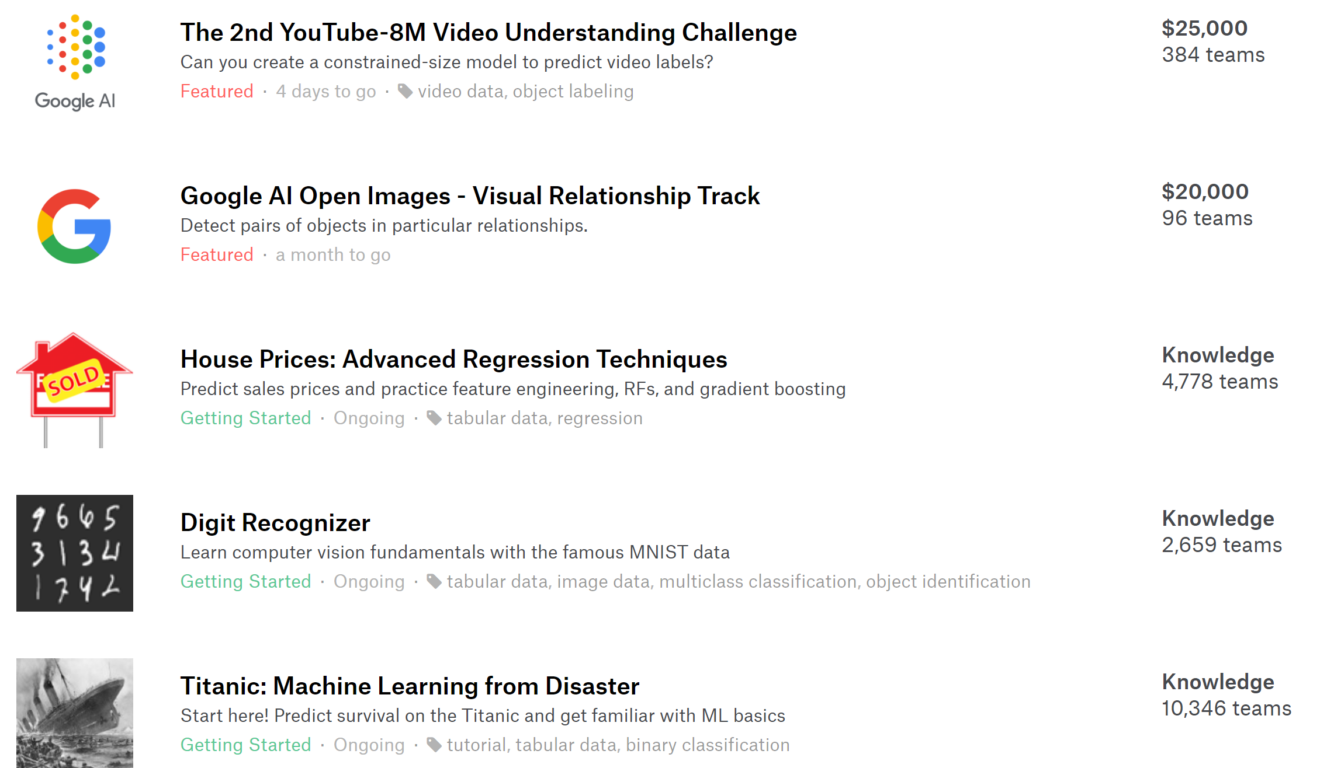
(2) Data Analytics Group Project
Only Kaggle competition with award
For “Knowledge” ones, many people share their codes.
X
X
X

Slide 22
Schedule
Data Product Idea Generation (~ W4)
Next Friday (W3), bring several rough ideas.
W3 & W4 Laura Earl from UNSW MCIC (45 min) to help you innovative ideas.
Let me know your idea by W4.
Progress report (W6)
Final reprot (W10)

